Slide 1
Predicting Urban Pesticide Runoff in the Sacramento-San Joaquin Delta
Emma Chelsvigª, ….to edit… Yuzhou Luo^{b}, Debra Denton^{c}, Ann Pitchford^{d}, Sandy Raimondo^{e}, Donald Ebert^{e}, S. Thomas Purucker^{e}, Yongping Yuan^{e}
ªOak Ridge Institute of Science and Engineering (Chelsvig.Emma@epa.gov)
^{b}California Department of Pesticide Regulation (Yuzhou.Luo@cdpr.ca.gov)
^{c}U.S. Environmental Protection Agency Region 9 (Denton.Debra@epa.gov)
^{d}Retiree, previously U.S. Environmental Protection Agency, Office of Research and Development (pitchford3@cox.net)
^{e}U.S. Environmental Protection Agency, Office of Research and Development (Raimondo.Sandy@epa.gov, Ebert.Donald@epa.gov, Purucker.Tom@epa.gov, Yuan.Yongping@epa.gov)

Slide 2
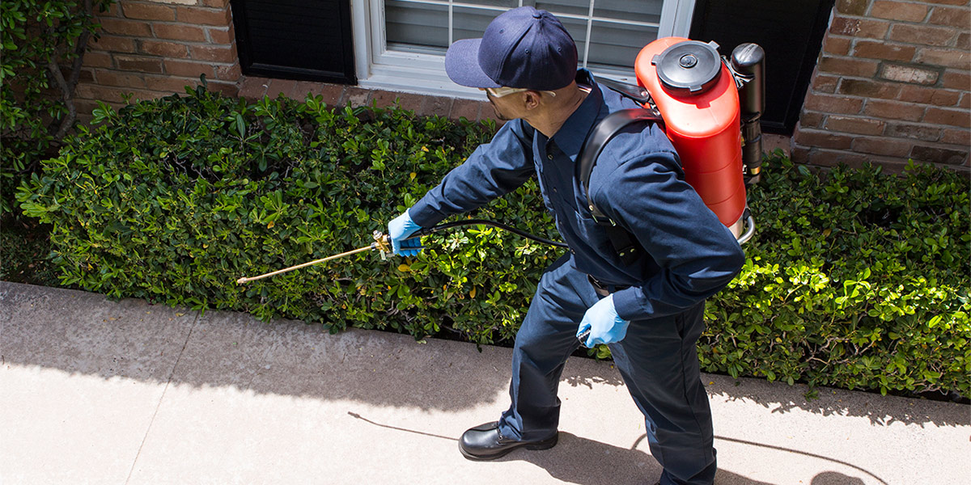
Goals
Employ deterministic and probabilistic approaches to simulate bifenthrin concentration in urban runoff
SWMM + VVWM
Identify sensitive input parameters
Notes:
Image Link: https://www.onlinepatiolawngardenstore.com/the-importance-of-resorting-to-customized-pest-control-solutions-in-arizona/

Slide 3
Background
Pyrethroids used by Professional Pest Control applicators and homeowners in residential settings
California Department of Pesticide Regulation (CDPR) observed ≥ 1 pyrethroids in 78% of samples, 2009 – 2018
Identified as leading cause of invertebrate toxicity
Pyrethroid detections often exceed US EPA aquatic life benchmarks
Impervious surfaces likely contribute to high observed concentrations
No current models equipped for variability of urban environment

Slide 4
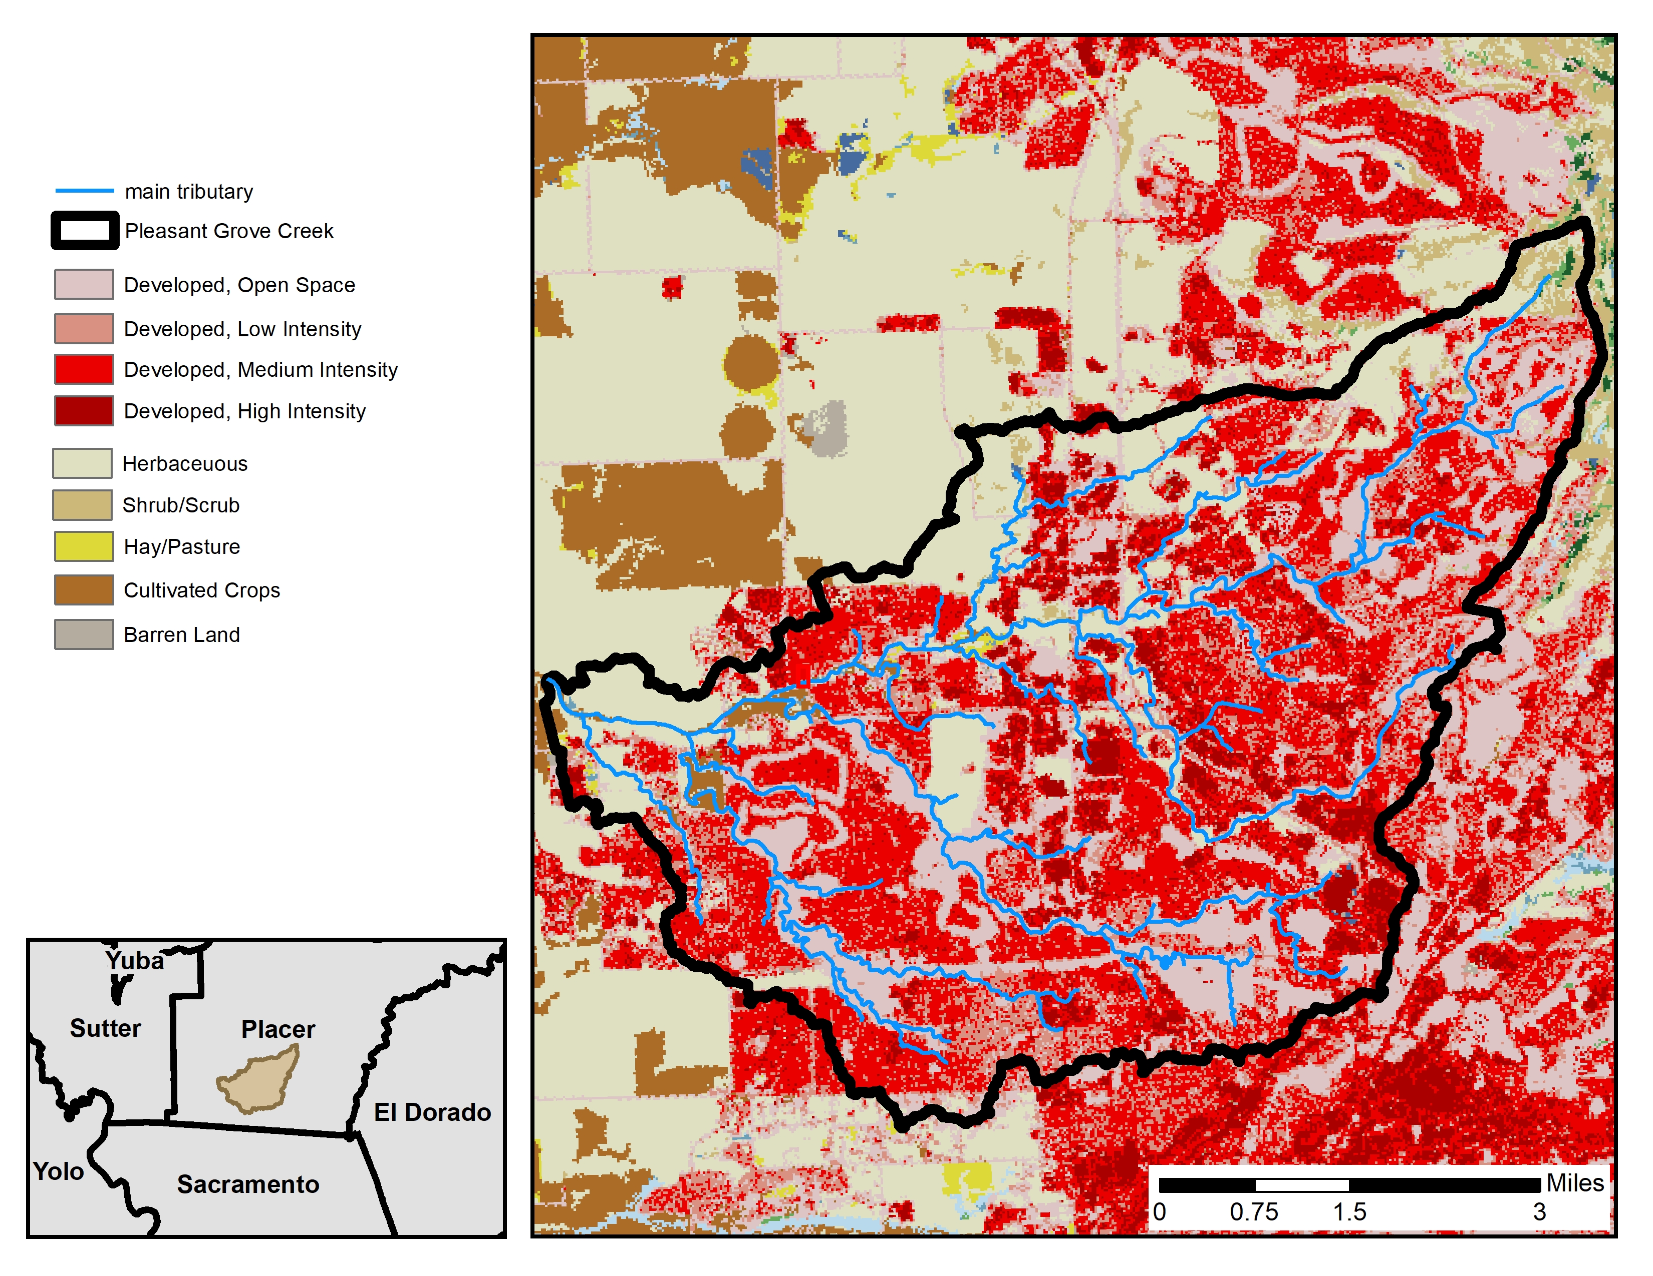
Notes:
Note: Use either this slide or the next slide (probably don’t need both)

Slide 5
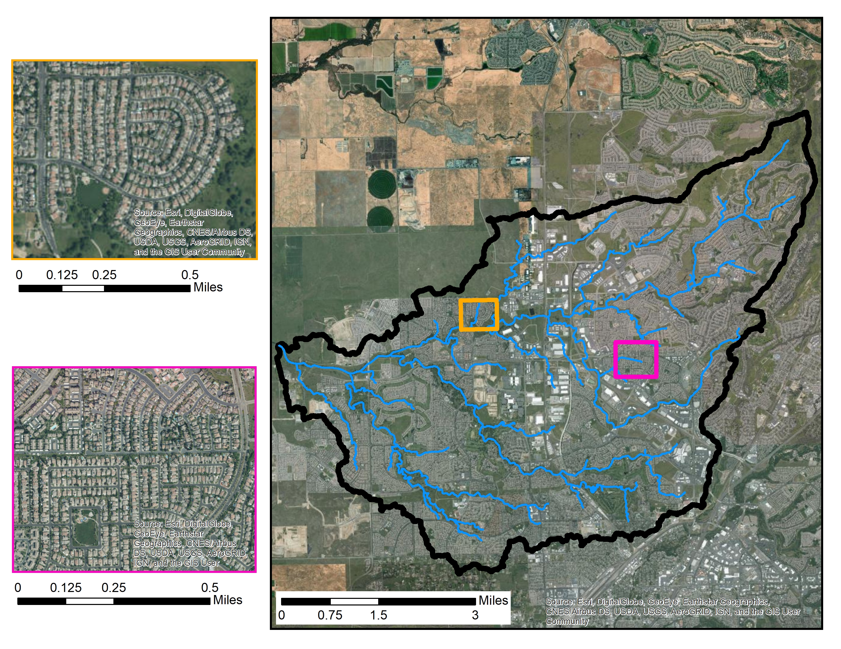
Notes:
Note: choose between this slide and the previous slide (probably don’t need both)

Slide 6

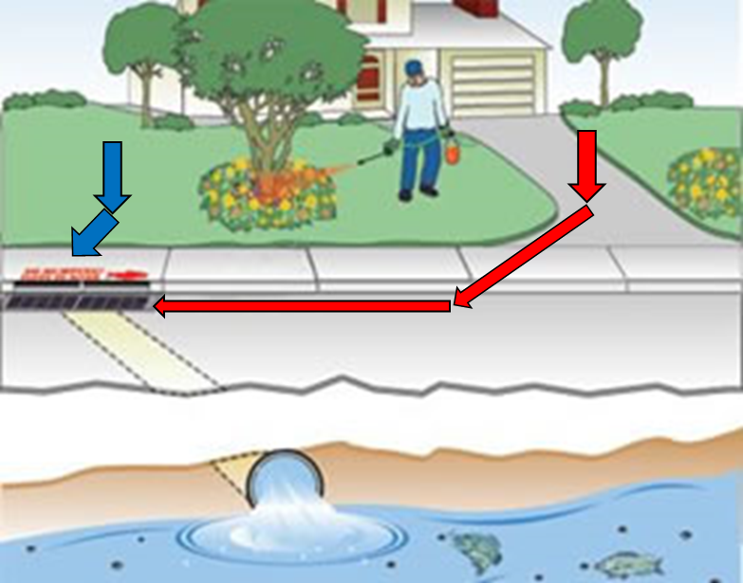
Bifenthrin
Rain
Literature Findings
Highest detection frequencies (DFs)
DFs nearly tripled during rainfall events
Highest concern for potential toxicity (e.g., Hyalella azteca)
Modeling Efforts
Urban-use categories, 2009 – 2017 (PUR)
Homeowner use: additional 20%
Aggregate data from county to watershed-level (Luo and Deng, 2015)
Monthly → Daily rates, with 30-day MA

Slide 7
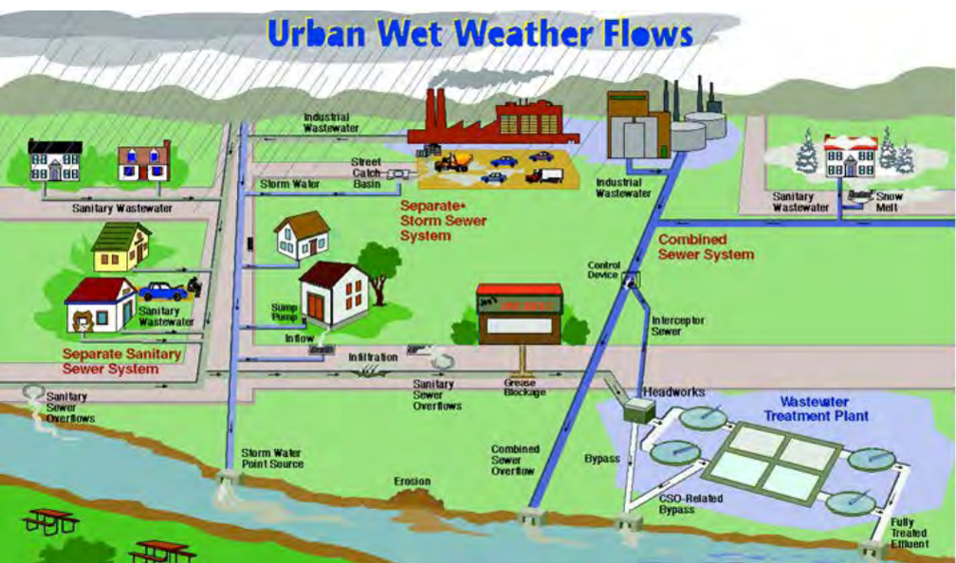
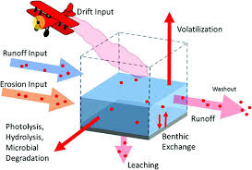
Model Selection
SWMM
VVWM
Storm Water Management Model (v 5.1)
Simulates rainfall-runoff scenarios
Best suited for urban environment
Variable Volume Water body Model (v ??)
Simulates water bodies receiving surface runoff
Estimate fate and concentration for water column and benthic region
Notes:
SWMM image link: https://www.epa.gov/water-research/storm-water-management-model-swmm
VVWM image link: https://pubs.acs.org/doi/pdf/10.1021/bk-2019-1308.ch016

Slide 8
Deterministic Model setup - SWMM -
Initial Setup
…
…
RAINGAGES
4 daily precipitation files from the City of Roseville
LANDUSES
Developed (open, low, medium, high)
Other (all other land use)
BUILDUP
External time series of application rates for Developed
WASHOFF
Exponential function for Developed
Coefficient = 1, Exponent = 0.066

Slide 9
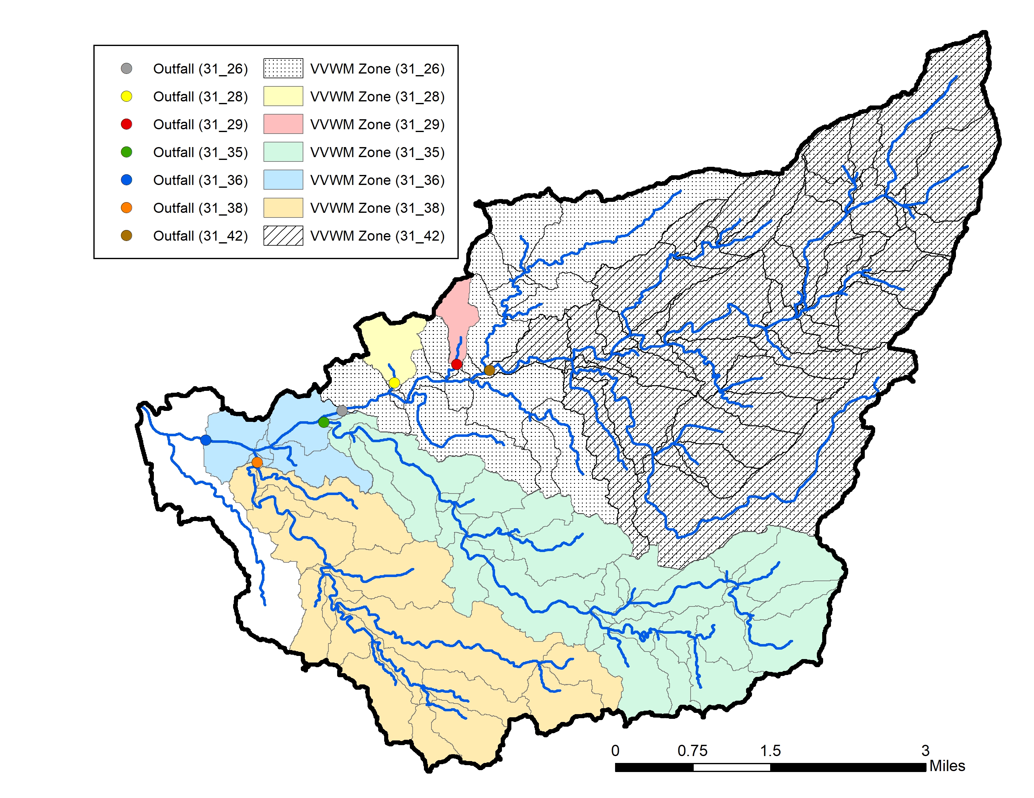
Deterministic Model setup - VVWM -
SWMM simulation forked into 7 VVWM simulations
Notes:
Insert map image of all 7 VVWM simulations

Slide 10
Deterministic Model setup - VVWM -
Convert SWMM outputs to VVWM-readable
bifenthrin concentration (ug/L) → g/ha/day
runoff flow (m³/sec) → cm/ha/day
.dvf Weather File
precipitation, temperature, wind speed, solar radiation, evapotransporation
precipitation files from SWMM simulation
remaining variables from US EPA Hydrologic Micro Services

Slide 11
Probabilistic Model setup
03_write_update_run_pwc.R
lhs_input_ranges.csv
PRZM5.exe
*.wea
06a_pcc_computation_daily.R
06b_pcc_computation_max.R
update
PRZM5.inp
copy
run PRZM
05_write_output_into_df.R
Compute PCC (daily and max)
02_lhs_parameterization.R
Create time array
Store outputs as time series (*.RData, *.csv))
Conduct Latin Hypercube sampling for each parameter
Create input data frame and store inputs (5000 values for each parameter)
*.zts
*.prn
04_write_update_vvwm.R
VVWM.exe
07a_pcc_graphics_daily.R
07a2_pcc_graphics_daily.R
07b_pcc_graphics_max.R
07c_percentile_graphics.R
update
copy
run VVWM
vvwmTransfer.txt
Create PCC graphics
Create percentiles plots
*.csv
*.txt
Notes:
NEED TO UPDATE ACCORDING TO SWMM / VVWM process!!

Slide 12
Notes:
THIS WILL LIKELY BE PLOTS OF RESULTS (SAME GOES FOR THE FOLLOWING SLIDES)

Slide 15
The End
Questions?

